Slide 1
Earnings Call
Stock Market Analysis
No Bulls*** Consulting Group
Joseph Chin, Jeremy Friedman, Aifaz Gowani, Shane Kok, Chris Kreke, Hannah Li
Notes:
Jeremy
Alternative Names:
1. Mo’ Money Consulting Group
2. BIG Money Consulting Group

Slide 2
Agenda
1
Overview
2
Summary of Data
3
Features
4
Models & Analysis
5
Conclusion
Notes:
Jeremy

Slide 3
Overview
Notes:
Jeremy

Slide 4
Business Case
Do the topics and sentiments in an earnings call help to predict future stock returns?
BUY
SELL
Notes:
Jeremy

Slide 5
Project Steps
Run Models
Derive
Features
Gather and Clean Data
Notes:
Jeremy

Slide 6
Summary of Data
Notes:
Joseph

Slide 7
Components of Data
Companies’
Technology Industry
Returns
&
Betas
(CRSP, Yahoo Finance)
Time Periods
(3, 7, 30, 90 days)
Earnings Calls
(Seeking Alpha)
Notes:
Joseph
When we decided to do this project, we were advised to limit our universe to only one industry to compare apples to apples, in our case we chose technology
then we grabbed company returns and betas from CRSP and Yahoo Finance. In terms of betas we grabbed the historical beta of firms when their earnings came out. then we grabbed returns 3 days 7 days 30 days and 90 days after the earnings call.
Last but not least, we scraped th earnings calls from seeking alpha with web scraper

Slide 8
Earnings Calls
Performance
Financial Statements
KPI’s
Growth/Decline Drivers
Litigation
Performance
Risks
Systematic Risk
Industry-specific Risk
Idiosyncratic Risk
Risks
Outlook
Outlook
Future Expected Performance
New Projects/Initiatives
Changes in Top Management
Notes:
Joseph
so why earnings calls?
earnings calls happen on the day of quarterly earnings release and provides a chance for investors to ask management questions. they usually revolve around performance, risks, and outlook. we want to see if the information in earnings calls provide people a chance to predict future stock prices.

Slide 9
Features
Notes:
Hannah

Slide 10
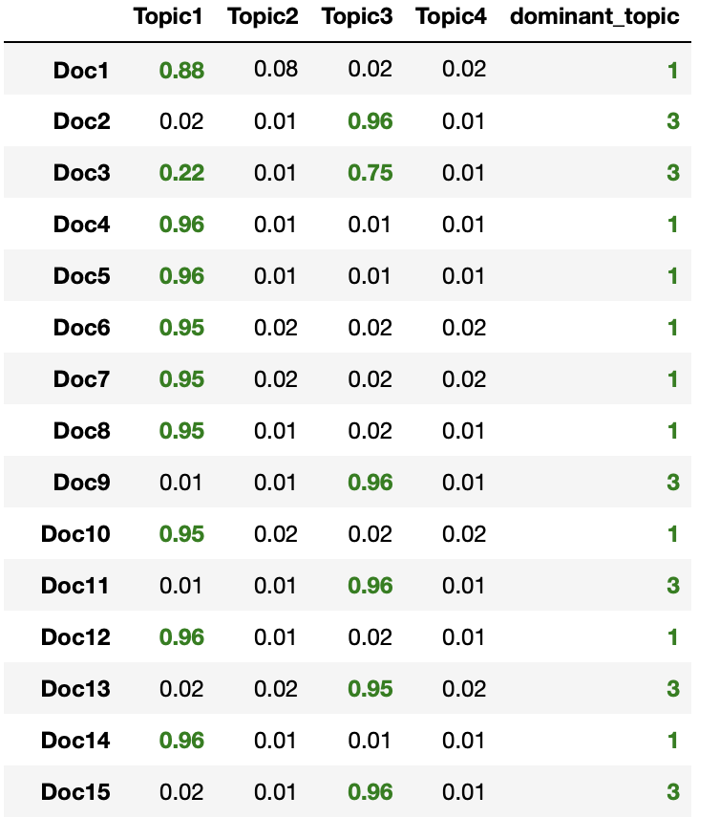
Topic Modeling
Steps:
Removed Names with Name-Entity Tagger
POS Tagging and Lemmatization
Optimized TF-IDF using Max DF Threshold=0.9
Ran LDA
Gensim
SKLearn
Found 4 Topics to be optimal
Tested 17 thresholds
Tried up to 20 topics
Log Likelihood & Perplexity
Notes:
Hannah
we wanted to see what topics we should get from these earnings calls to add as features to our models
we preprocessed the data by removing names from the text since we are grabbing our data from transcripts
we then did POS tagging and lemmatization
we computed TFIDF score but saw that words such as quarter, revenue, growth showed up in every document and caused our topics to be indistinguishable, so we used a maxdf threshold of .9 to account for this
we ran LDA using Gensim and SKlearn and obtained our topics
we optimized the number of topics by testing 17 max df thresholds and 20 topics, and looked at the log likelihood and perplexity -- obtained 4

Slide 11
Topic Modeling
 | #1 Consumer |  | #2 Online Platforms |  | #3 Cloud Computing |  | #4 Financial/ Performance Metrics
Inventory |  | eBay |  | Service |  | NYSE
Segment |  | PayPal |  | Cloud |  | Credit
Demand |  | Alphabet |  | Storage |  | The Balance
Consumer |  | Craigslist |  | Enterprise |  | The Capabilities
People |  | Venmo |  | Hardware |  | Basis Points
Notes:
Hannah
these are the topics we obtained
we see that most documents fall in topic 1 (consumer) and topic 3 (cloud computing) which makes sense for our data

Slide 12
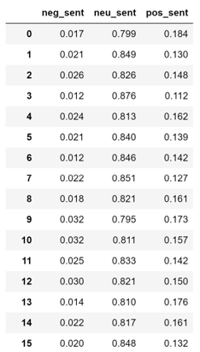
Sentiment Scores
Does Sentiment affect
the returns of stocks?
Notes:
Chris

Slide 13
Creating Dependent Variable
Calculated firms’ expected returns using historical betas and market risk premiums at a specific point in time
Compared actual returns to the firms’ expected return
Tested 4 different time periods: 3, 7, 30, 90 days
Notes:
Chris

Slide 14
Models & Analysis
Notes:
Aifaz

Slide 15
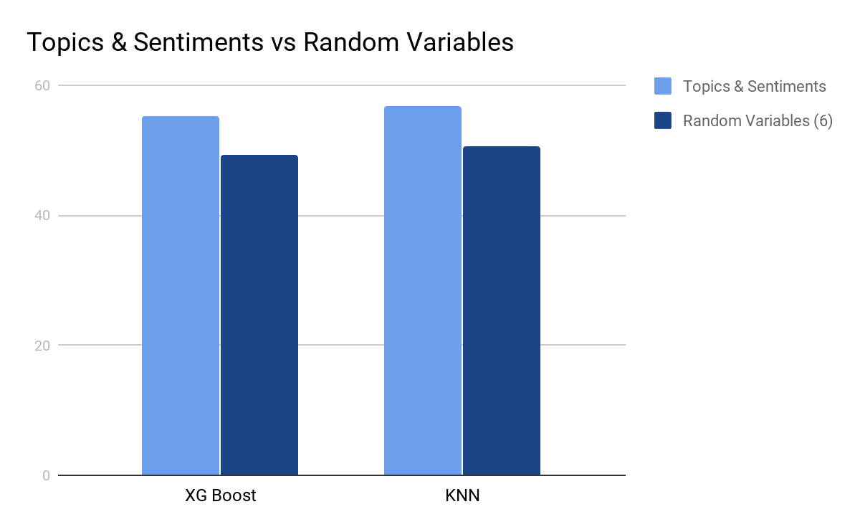
AUROC Scores

Slide 16
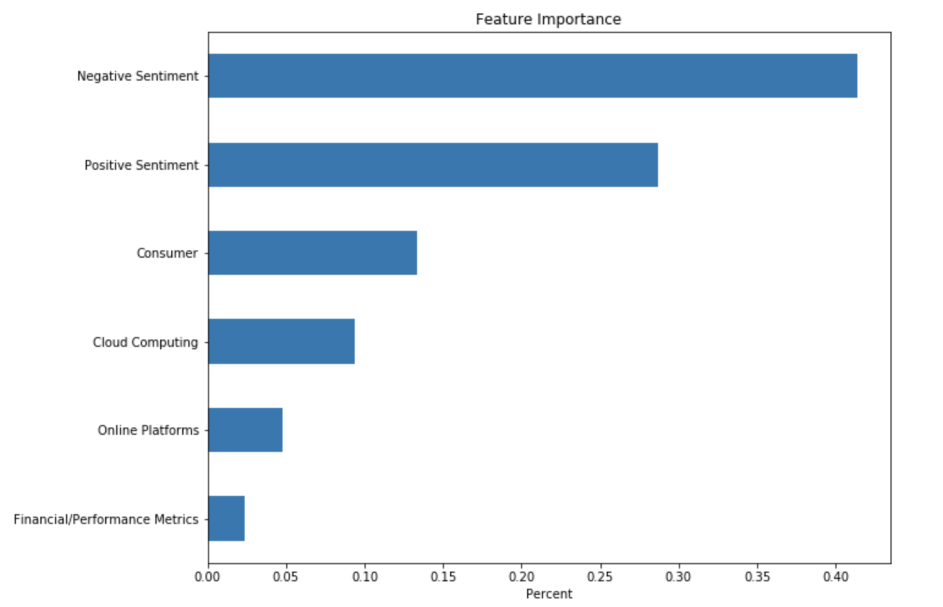
XGBoost (Feature Importance)
Notes:
Aifaz

Slide 17
Conclusion
Notes:
Shane

Slide 18
Average Scores of
Topics & Sentiments
 | Negative Sentiment | Positive Sentiment | Consumer | Online Platforms | Cloud Computing | Financial/ Performance Metrics
Overperformers | 2.1% | 14.7% | 66.4% | 1.8% | 30.1% | 1.8%
Underperformers | 2.1% | 14.6% | 63.7% | 1.8% | 32.9% | 1.7%
Notes:
Shane

Slide 19

Key Takeaways
Negative Sentiment
Saw most significant effects in 30-day time period
Earnings calls have some predictive power of stock performance
Companies that overperformed talked more about consumers
Sentiments especially negative sentiment have more predictive power than positive sentiment
Earnings Calls
Consumers
30-day period
Notes:
SHane

Slide 20
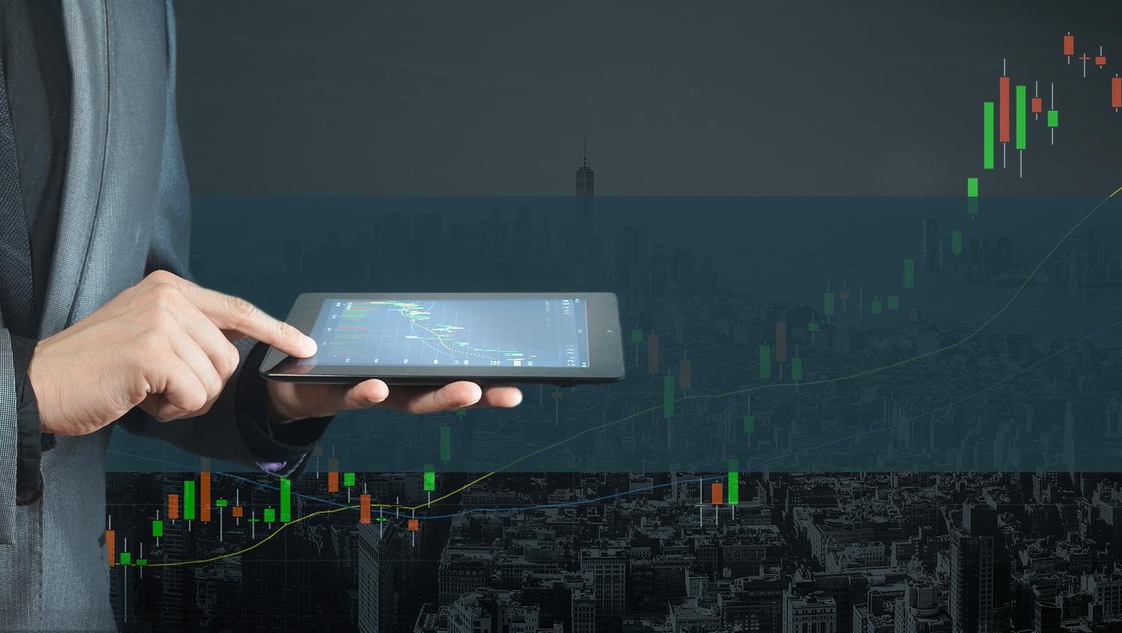
Thank You
Questions?

Slide 21
Appendix

Slide 22
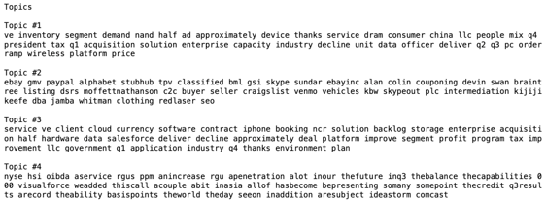
Topic Modeling

Slide 23
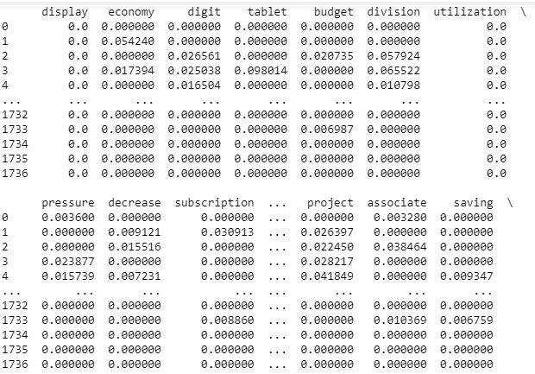
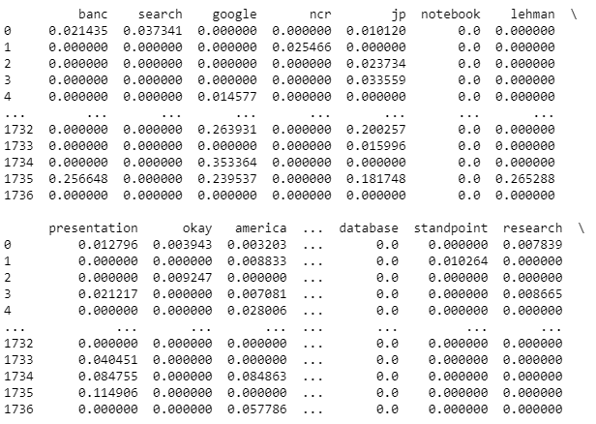
TF-IDF Scores
Top 20% of Companies By Returns (90-days)
Bottom 20% of Companies By Returns (90-days)

